Slide 1
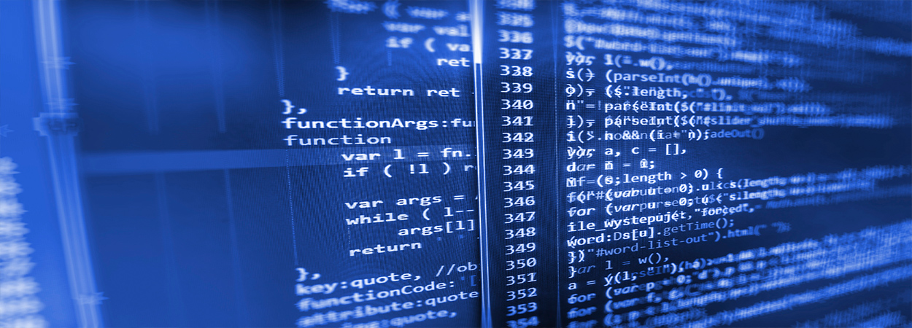
Burn wound healing model
Mark de Boer
Ben Dickens

Slide 2
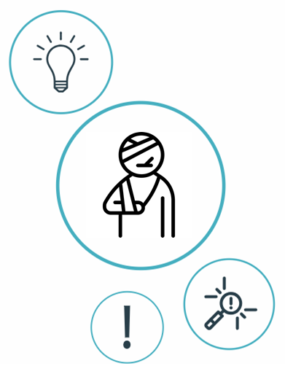
Index
Introduction
Previously built models
Proposal
Possible biomarkers
Possible sociomarkers
Data available?

Slide 3
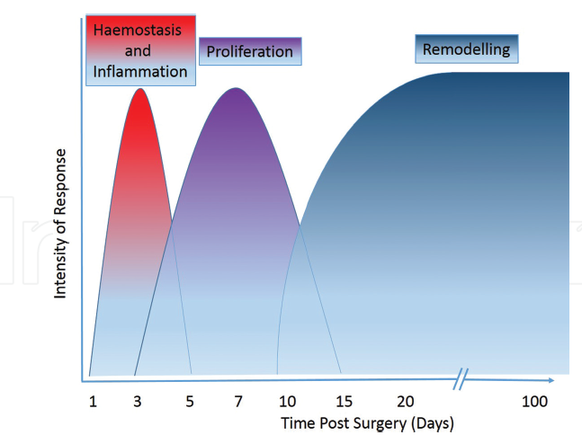
Stages of healing
4 Stages
When a patient comes in, they are likely to have gone through the first stage of response.
Inflammatory response is fundamental to the healing process:
Fight infection, clear debris and induce the proliferation phase <-> Tissue damage
Notes:
Inflammation helps, clear debris and induce the proliferation phase (fibroblasts entering, then angiogenesis), but may lead to tissue damage if it lasts too long. This is often the case when: unable to clear debris, excessive detritus, devitalised tissue, or microbial biofilm is present.

Slide 4
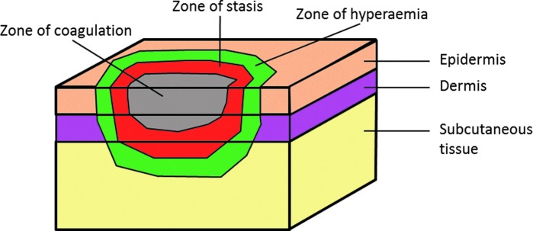
Zones of injury
Burns consist of three zones of injury
Main difference from cuteanous wounds is the the loss of the skin appendages and re-epithelialization, which can only occur from the edges of the wound.

Slide 5
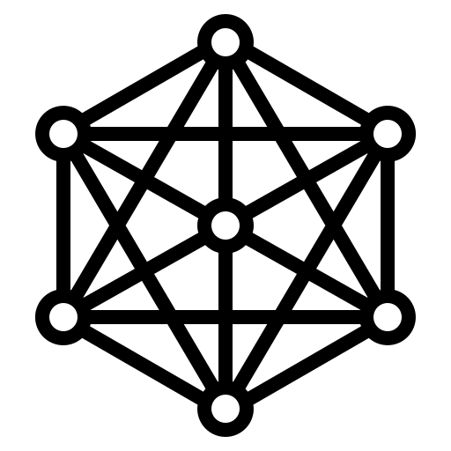
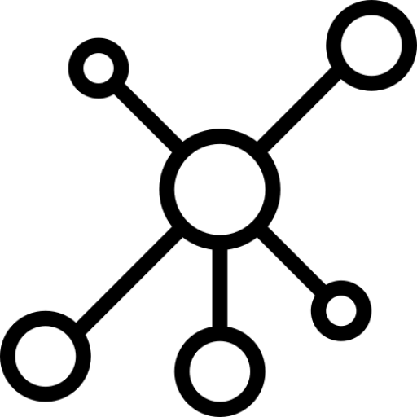
Previously built models
Dynamic ABM/EBM computational frameworks simulating
cutaneous wound healing (Inflammation, Proliferation, Remodeling)
Dynamic EBM computational Alkaline Phosphatase (AP) models
to study the immune response process in wound healing.
Notes:
Perfect skin regeneration of burn wounds remains a challenge. There is still a lack of fundamental understanding of the interactions between different cell types, complex cell signalling networks and mechanical feedback loops during the wound healing process. Previous efforts have focused on constructing dynamic computational frameworks simulating cutaneous wound healing [1,2,3], but have not focused on burn wound healing.
In addition, dynamic computational models have been used to study the inflammation process in wound healing. Presbitero et al. [4] constructed a validated numerical systemic inflammation model under clinical treatment conditions of the Alkaline Phosphatase enzyme. Alkaline phosphatase (AP) exhibits anti-inflammatory effects by dephosphorylating inflammation triggering moieties (ITMs) like bacterial lipopolysaccharides and extracellular nucleotides.
These models are all not burn wound specific, therefore adjustments or an expansion of these models are demanded, to simulate the burn wound procedure. The link between the AP model and the cutaneous wound healing models, has not been investigated/found yet. By first performing a literature review focused on possible connections, this will be investigated. Constructing a computational model simulating burn wound healing would be a step forward towards a better understanding of dynamical adaptation to heal burn wounds.
ABM: simulating the actions and interactions of autonomous agents (both individual or collective entities such as organizations or groups) with a view to assessing their effects on the system as a whole

Slide 6
ABM
EBM
Simulating the actions and interactions of autonomous agents
Behaviors through which individuals interact with one another.
Discrete
Set of equations that expresses relationships among observables:
Time-varying ordinary differential equations (ODE)
Space- time varying partial differential equations (PDE)
Continuous
Notes:
ABM: (both individual or collective entities such as organizations or groups) with a view to assessing their effects on the system as a whole
Although epidemiological ABMs and EBMs share common
goals, they differ in how they model the fundamental
relationships among entities and attention to the level-of-
detail. Both approaches operate in a world that includes
entities and observables tracked over a temporal period.
Observables within the models are measurable characteristics
of actionable interest.

Slide 7
Tepole et al. ~
Computational modeling of chemo-bio-mechanical
Coupling toward
wound healing
Flegg et al. ~
On the mathematical modeling of wound healing angiogenesis
Boon et al. ~
A multi-agent cell-based model for wound contraction
Li et al. 2011 ~ Biosimulation of Acute Phonotrauma: an Extended Model
2011
2014
2015
2016
2007
2013
2017
2018
Mi et al. ~
Agent-based model of inflammation and wound healing
Ziraldo et al. ~
Computational Modeling of Inflammation and Wound Healing
Tepole et al. ~
Computational systems mechanobiology of Wound Healing
Sloot et al. ~
Alkaline Phospatase and it’s role in the Immune System

Slide 8
Ziraldo et al. 2013 ~ Computational Modeling of Inflammation and Wound Healing
SPARK-PL (Java)
2-Dimensional ABM model
Inflammation
Relevant cell populations:
Endothelial cells
Macrophages
Neutrophils
Fibroblasts
Key effector cytokines :
TNF-α
IL-1β
IL-10T
TGF-β1

Slide 9
Li et al. 2011 ~ Biosimulation of Acute Phonotrauma: an Extended Model
2-Dimensional ABM model
Inflammation + synthesis of collagen/elastin (link to contraction)
Relevant cell populations:
Platelets
Macrophages
Neutrophils
Fibroblasts
Fibres:
Collagen
Elastin
Key effector cytokines :
TNF-α
IL-1/6/8/10
TGF-β1
bFGF

Slide 10
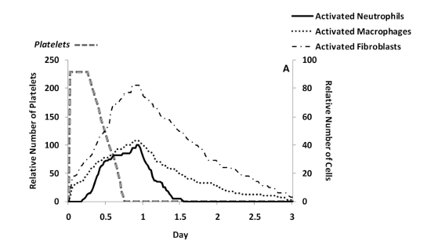
Predicted cell trajectories for platelets, activated neutrophils, activated macrophages and activated fibroblasts.
Predicted ECM trajectories for new
collagen, new elastin and new hyaluronan

Slide 11
Boon et al. 2016 ~ A multi-agent cell-based model for wound contraction
Matlab
3-Dimensional multi-agent cell-based hybrid model
Contraction (The mechanical pulling of (myo-)fibroblasts on the ECM)
Relevant cell populations:
Leukocytes (to simplify
Fibroblasts
myofibroblasts
Fibres:
Collagen
Fibrin
Key effector Cytokines/ Chemokines :
tPA
PDGF
TGF-β
Notes:
Themodelisbasedonacell-basedformalism where fibroblasts, myofibroblasts andtheimmunereactionaretakenintoaccount.Themodelisusedto simulate contractionofawoundusingpointforcesonthecellboundar nthisprocess,thecellsadheretotheextracellular matrix (orECM).TheECMisco
mprisedmostlyofcollagen fibrils yanditalsodeterminesthe orientation ofcollagenafterrestorationofthedamage.
These aspects included cellspeed, flux, polarisation, density, initial matrix orientation and the influence of cells on the matrix.
Cleaning function of leukocytes not incorporated.
tPA (fibrin decay), PDGF (leukocytes atraction), TGFB (attraction fibroblasts)
Therefore,we assume that the cell migration speed decreases as they move deeper away into the wound area.The reason for this is that the cells less easily find rigid spots to adhere to in the loosely connected regions.

Slide 12
3D Fibrin profiles at consecutive times for t=0h, t=1h, t=2h and t=5 h.
Also for Collagen/ TGF

Slide 13
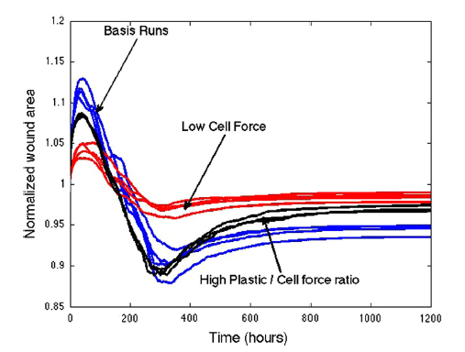
One of the most problematic issues regarding severe burns or deep wounds is the permanent contraction of the wound.
Notes:
Fibroblasts located outside the wounds -> in undamaged tissue so first expands, cause already pulling
Fibroblasts into the wound

Slide 14
Tepole et al. 2017 ~ Computational systems mechanobiology of Wound Healing
2-Dimensional EBM model
Proliferation and Remodeling
Modeling Angiogenesis, Contraction and Re-epithelialization
Including changes in relevant cell populations (Endothelial cells, Macrophages, Fibroblasts, Myofibroblasts, Keratinocytes) and their key effector cytokines (TGF-α, FGF-7, PDGF, TGF-β1, FGF(1,2,4), VEGF), and mechanical loads

Slide 15


Research Questions + Aim:
What causes a better healing of burn wounds?
What is the link between the AP model and the cutaneous wound healing model?
A novel computational framework combining the AP and ABM models
to simulate the healing of burn wounds

Slide 16

Proposal
Discrete Spatio-temporal (existing in both space and time) Agent-Based Model combining both the immune response model and the ABM wound healing models
The AP model will act like an engine for the blood composition of a 2/3-dimensional ABM model.

Slide 17
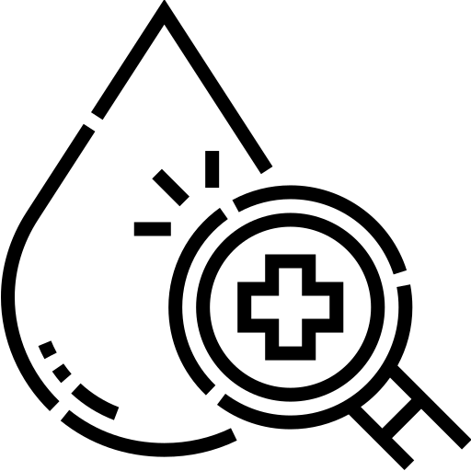
Blood Composition
Pro-inflammatory Cytokines:
IL-8
IL-6
IL-1β
TNF-α
Anti-inflammatory Cytokines
Interleukin 10 (IL-10)
IL-6
TGF-β
Other:
C-reactive protein (CRP)
Leptin
Neutrophils
Macrophages
TGF-α

Slide 18

Relevant parameters/markers
Geometrical Paramaters:
Length
Width
Depth of burn
Surface
Volume
Total Body surface area of burn (TBSA)
Burn Location/s
Relevant Socio-markers
Age
Weight
Height
Gender
Skin type

Slide 19

Data available?

Slide 20

Conclusion

